Slide 2

The Virtual Road Trip
A Power Platform Story
Notes:
Photo by Dominika Roseclay: https://www.pexels.com/photo/person-wearing-beige-sweater-holding-map-inside-vehicle-1252500/

Slide 3









Sponsors
Thank you!
We couldn’t do it without you.

Slide 4

bit.ly/3fpjn5V

Slide 5

Notes:
Photo by Andrea Piacquadio: https://www.pexels.com/photo/cheerful-man-using-laptop-for-video-call-3799821/
In the middle of the pandemic when we were working from home
Do remember teams calls, zoom calls, remote meetings?

Slide 7
Employee owned

Slide 8

Notes:
Photo by Erik Mclean on Unsplash
So how could be encourage people to exercise?

Slide 9

James Frost had an idea
(my boss)

Slide 10


Slide 11
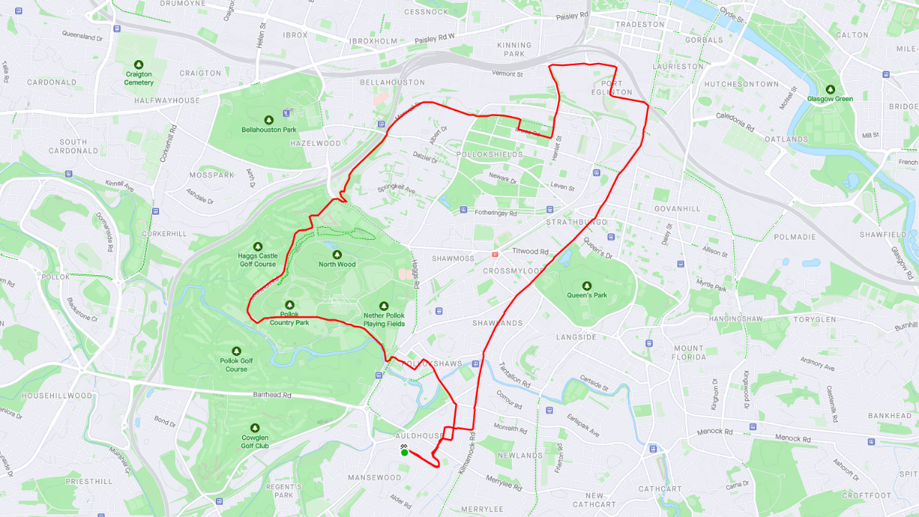

Slide 12
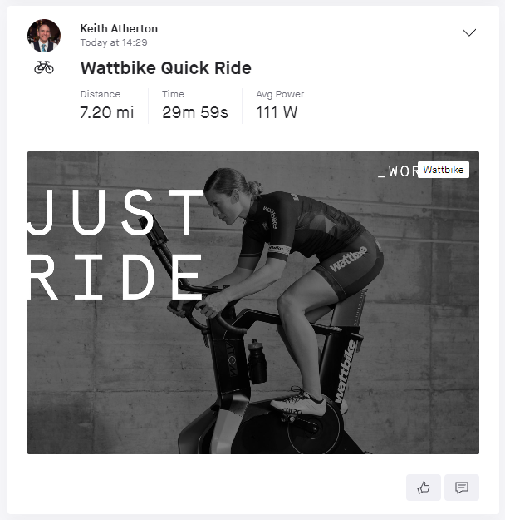
Notes:
And those who prefer to use exercise machines may also have the option to connect to Strava.

Slide 13


Slide 14


Slide 15




Slide 16

Notes:
https://tenor.com/view/magic-shia-la-beouf-gif-4410002

Slide 17
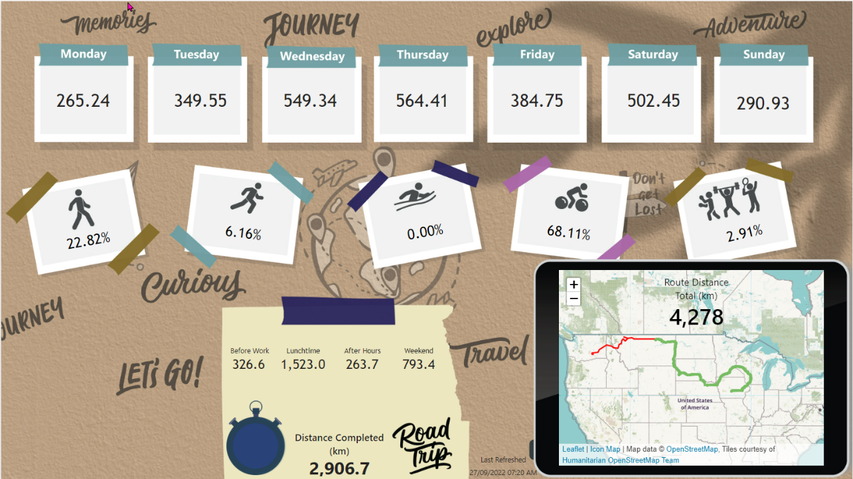

Slide 18

Notes:
Photo by Nick Seagrave on Unsplash
This project has been a journey

Slide 19

Notes:
Photo by Glenn Carstens-Peters on Unsplash
So what are we going to talk about?

Slide 20


Slide 21


Slide 22


Slide 23


Slide 24


Slide 25

Notes:
Photo by Marvin Meyer on Unsplash
What we have told is build by a team of people not one person
Also a number of different technologies

Slide 26


Slide 27

Not about this
Notes:
Photo by Jake Ingle on Unsplash

Slide 28




Notes:
Very often we only see 5% of a project. Often people are not aware of the huge amount of work that happens in the background to achieve results

Slide 29

Notes:
Photo by Sean Foster on Unsplash
We also might speak about some of the unexpected detours we encountered as we over came some challenges

Slide 30

Notes:
Photo by FORTYTWO on Unsplash
This project is like lego bricks we have taken small parts and combined them into one larger project

Slide 31

Notes:
Photo by Aedrian on Unsplash
We just combined them in different ways to create

Slide 32

Notes:
Photo by Phil Hearing on Unsplash
To make something unique yes not everyone will like it ☺

Slide 33
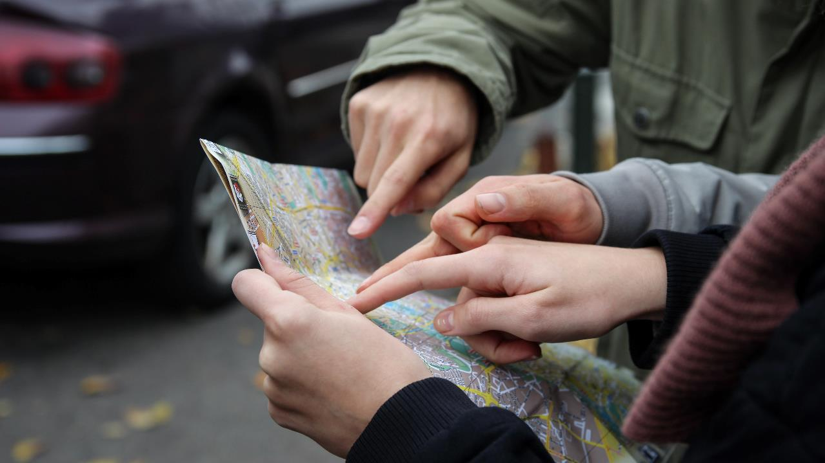
Notes:
Photo by Sebastian Herrmann on Unsplash
About the journey

Slide 34





Darren Phillips
Marketing Guru
Graphics Genius
Fantastic Barista
Darren.Phillips@qnrl.com
@DaristaBarista
linkedin.com/in/darrenphillips1984/
https://www.qnrl.com/

Slide 35


Keith Atherton
Senior Developer with Quorum
Lives near Edinburgh, Scotland
[Not from there originally 🤫]
Keith.Atherton@qnrl.com
@MrKeithAtherton
https://www.linkedin.com/in/keith-atherton/
https://www.qnrl.com/
Notes:
My name is Keith Atherton, I'm a Senior Developer at Quorum and, like Rob, I also joined Quorum during the pandemic.
Most of my time is spent with the Power Platform, specifically Power Apps, Power Automate and anything that we think can help our clients.
My contact details are on screen now. Feel free to contact me directly after this session.
Rob, over to you.

Slide 36
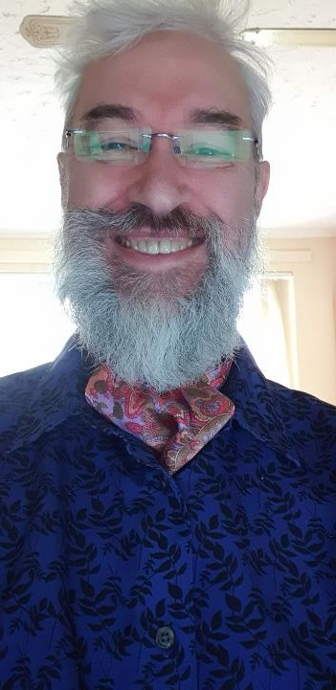
Robert French
Chief Power BI Nerd with Quorum
Lives in Sunny Glasgow, Scotland
Robert.French@qnrl.com
@sqlbobscot
https://www.linkedin.com/in/rwlpfrench/
https://www.qnrl.com/

Slide 37

Notes:
Photo by Suzy Hazelwood: https://www.pexels.com/photo/notebook-1226398/
What will we be talking about?

Slide 38

Notes:
Photo by Gia Oris on Unsplash
Start – how did we get started?

Slide 39
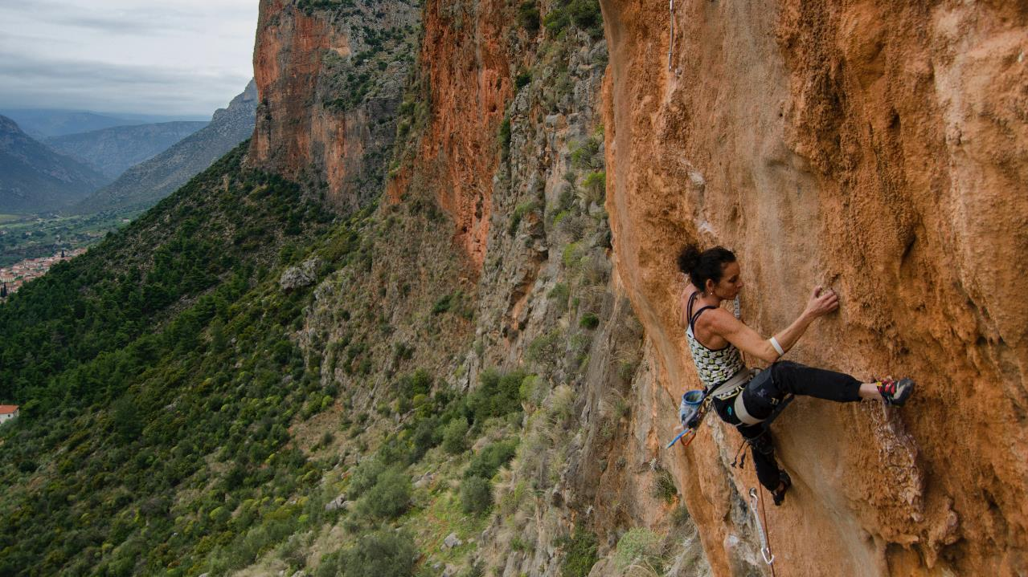
Notes:
Photo by Fionn Claydon on Unsplash

Slide 40

Notes:
Photo by Los Muertos Crew: https://www.pexels.com/photo/a-baker-making-a-cake-in-a-kitchen-8477963/
Adding icing to the cake

Slide 41

Notes:
Photo by Brett Jordan: https://www.pexels.com/photo/wood-typography-photography-blur-7939943/
Lets get started

Slide 42
Notes:
Photo by Gia Oris on Unsplash
Start – how did we get started?

Slide 43

“Robert your boss has told me you can work on this Power BI report idea..”

Slide 44

“That’s fantastic Darren, can you show me the idea?”

Slide 45
Dramatic pause
(my boss had to email to me)

Slide 46
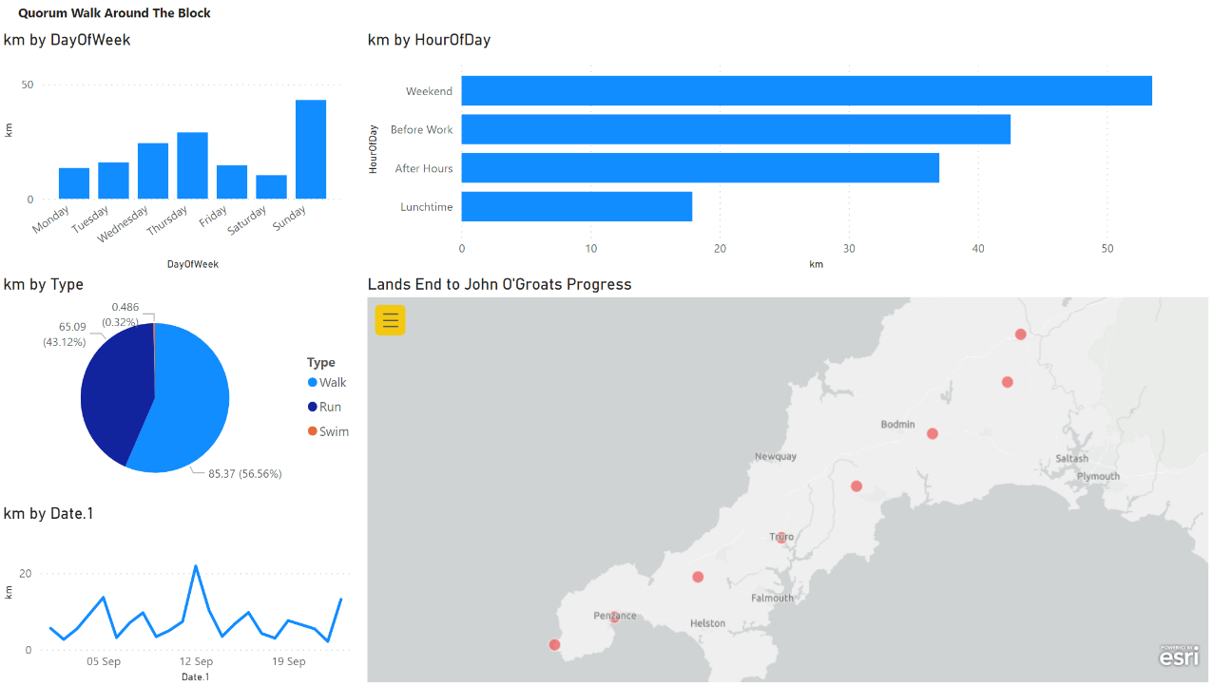
Notes:
This was v0.1

Slide 47

Notes:
Photo by Usman Yousaf on Unsplash
This was my reaction on seeing the report

Slide 48
Notes:
This was v0.1

Slide 49

Notes:
Photo by Brett Jordan on Unsplash
I reckoned with could do better

Slide 50
First
challenge

Slide 51





Slide 52

Notes:
So we talked about the layout had some conversations

Slide 53


Notes:
Darren had some ideas ! Following our conversations
Since Darren is not hear to talk them or defend the way I used his photo, then I can say what I like

Slide 54
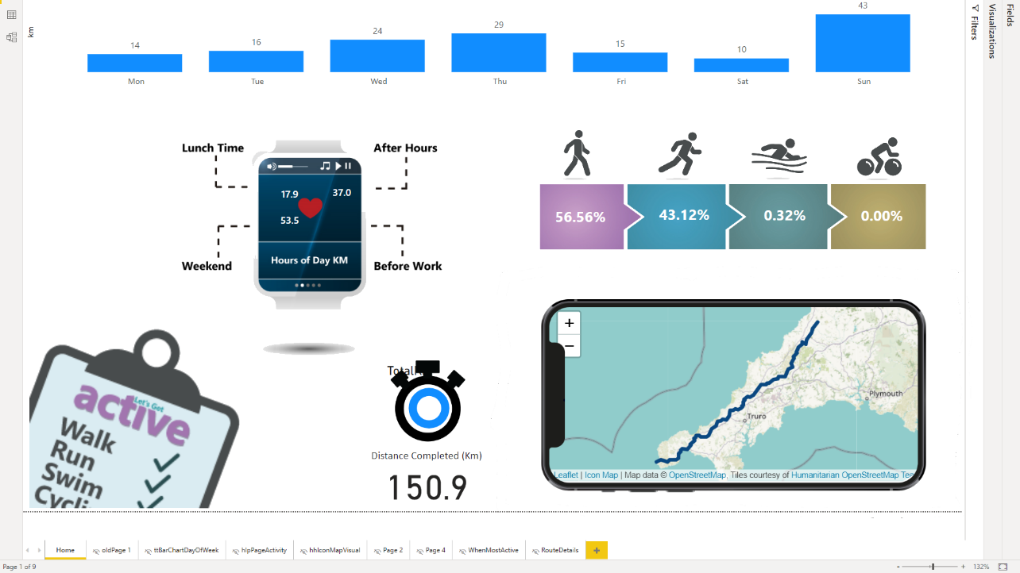

Slide 55

Darren says
Notes:
Photo by Florian Schmetz on Unsplash
Darren thought No

Slide 56

Notes:
Photo by fauxels: https://www.pexels.com/photo/colleagues-looking-at-survey-sheet-3183153/

Slide 57
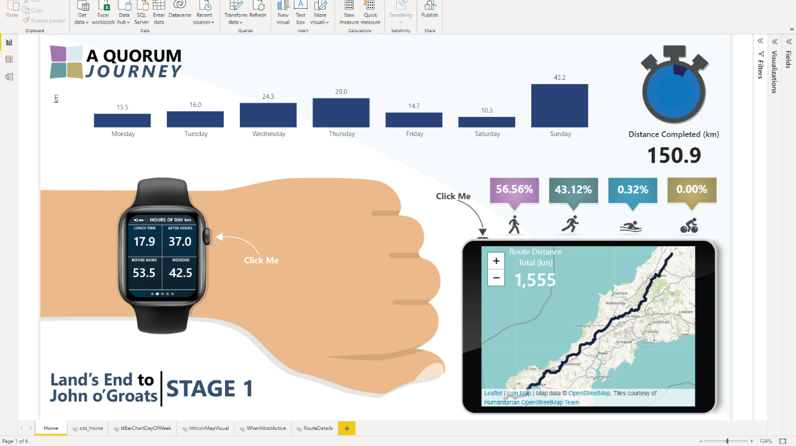

Slide 58
Now with added
Quorum-inmation
(animation)

Slide 59
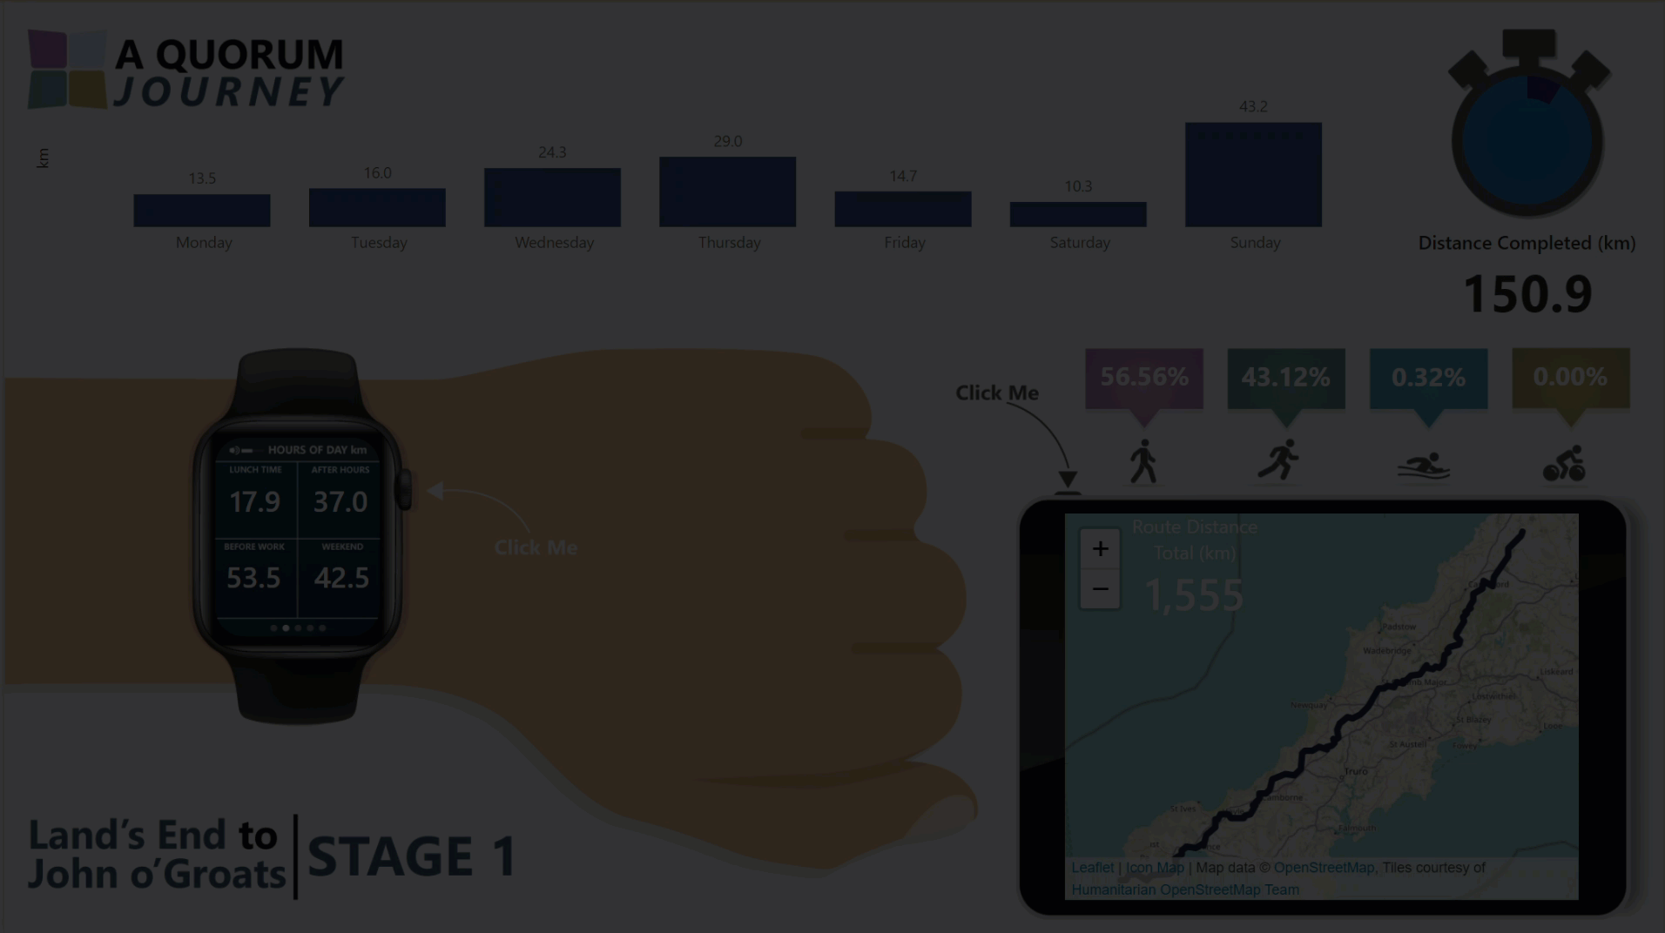

Slide 60

How ?
Notes:
Photo by Chris Arthur-Collins on Unsplash
How did they do that?

Slide 61

Notes:
So first how do we get the data into Azure Data Factory?

Slide 62




Slide 63
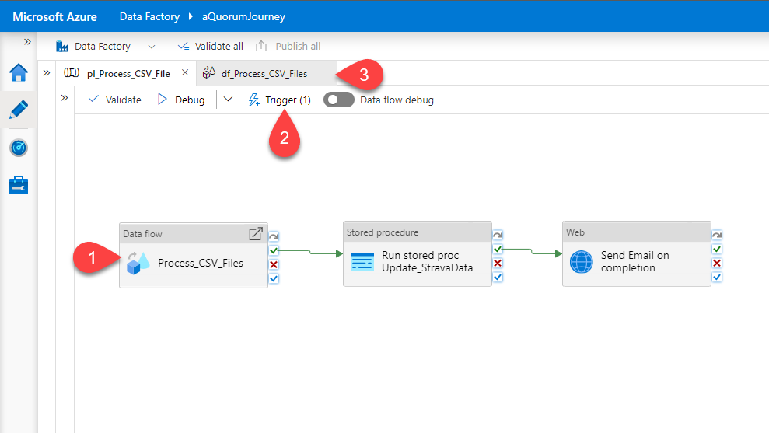

Slide 64
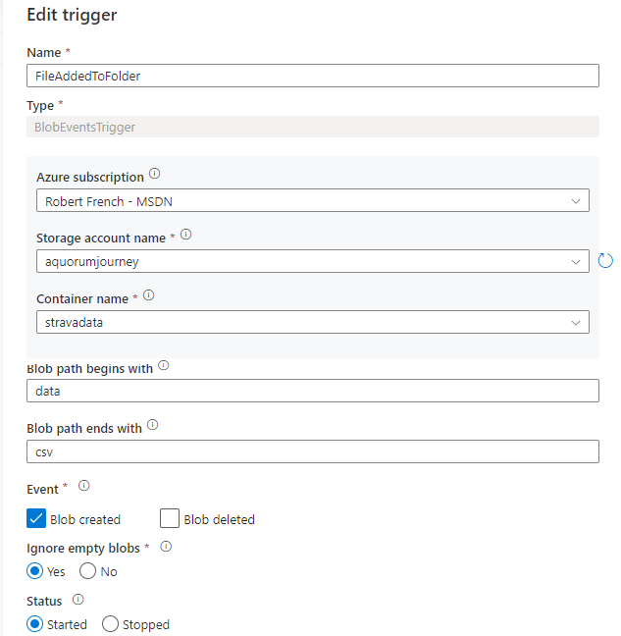


Slide 65

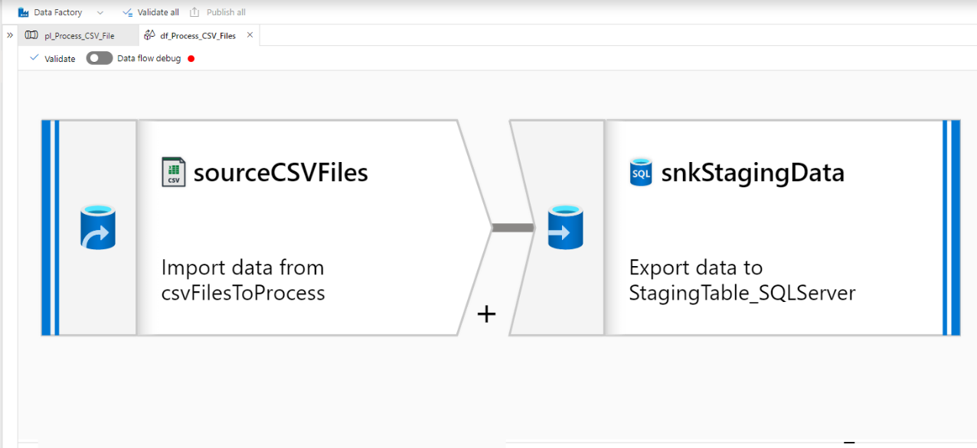

Slide 67
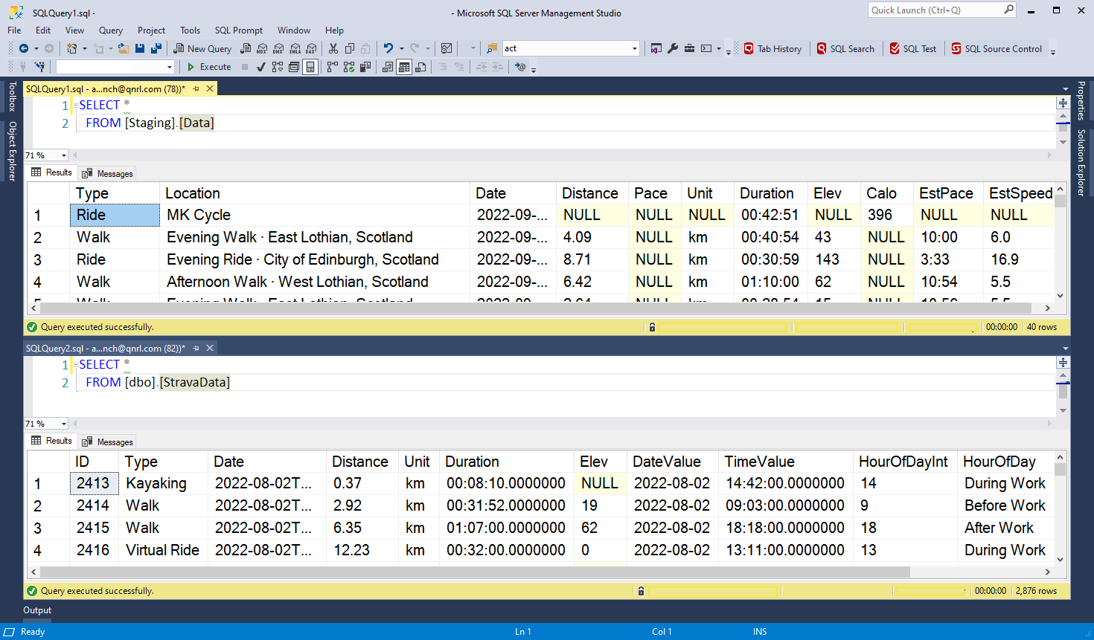

Slide 68

Notes:
Photo by Miikka Luotio on Unsplash
Yawn not very exicting we agree
Simple can be good though

Slide 69
Second challenge

Slide 70
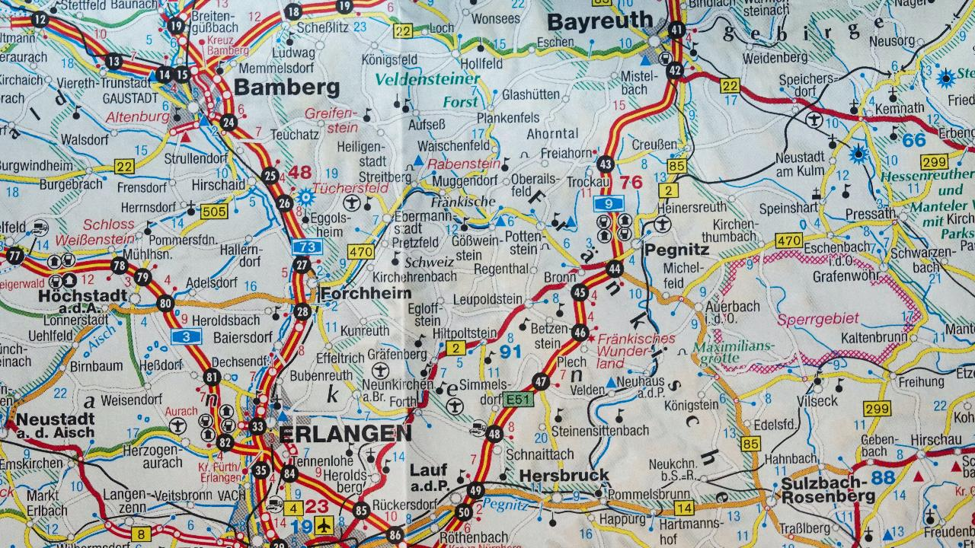
Notes:
Photo by Thomas Kinto on Unsplash
The route

Slide 71
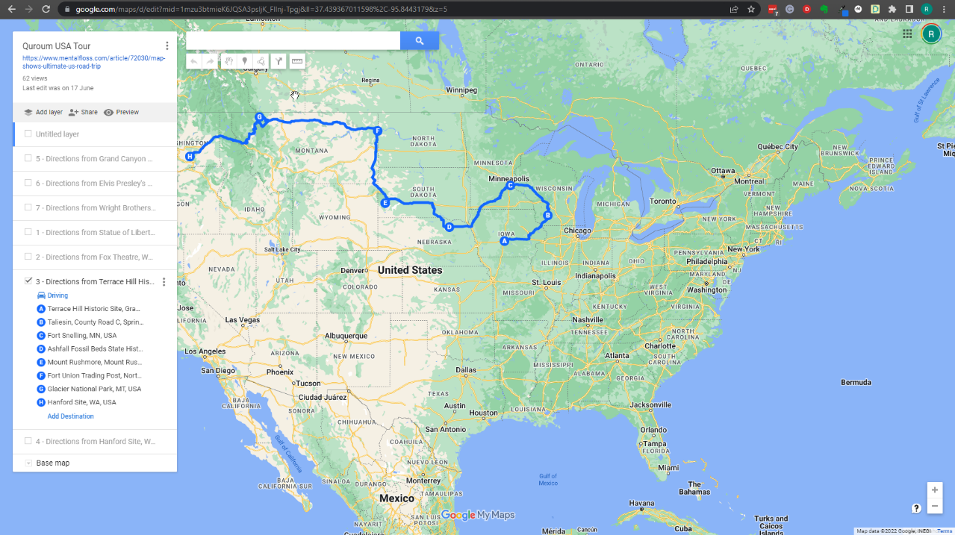

Slide 72

Notes:
This was great !

Slide 73


Slide 74
Notes:
Photo by Sean Foster on Unsplash
Bit of detour

Slide 75

Notes:
Photo by Usman Yousaf on Unsplash
However it could not be imported in SQL Server.

Slide 76
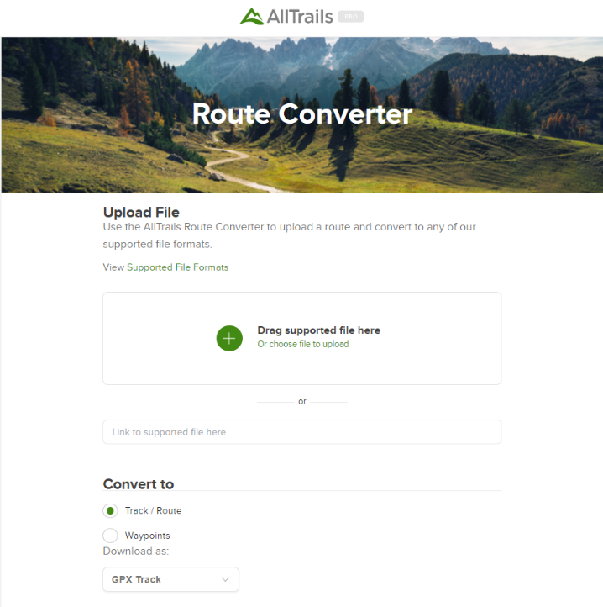

Slide 77
This will produce a ‘SQL script’ like this one
#CREATE TABLE tracks (
# fileId VARCHAR(16) NOT NULL,
# idx INT NOT NULL,
# lat DOUBLE NOT NULL,
# lon DOUBLE NOT NULL,
# ele DOUBLE NULL,
# PRIMARY KEY (fileId, idx)
#);
INSERT INTO tracks (fileId, idx, lat, lon, ele) VALUES ('null', '1', '42.33876000', '-83.0525900', '190.0');
INSERT INTO tracks (fileId, idx, lat, lon, ele) VALUES ('null', '2', '42.33762000', '-83.0552800', '184.0');
INSERT INTO tracks (fileId, idx, lat, lon, ele) VALUES ('null', '3', '42.33822000', '-83.0557500', '180.0');
INSERT INTO tracks (fileId, idx, lat, lon, ele) VALUES ('null', '4', '42.33833000', '-83.0558200', '180.0');
INSERT INTO tracks (fileId, idx, lat, lon, ele) VALUES ('null', '5', '42.33839000', '-83.0558500', '180.0');
INSERT INTO tracks (fileId, idx, lat, lon, ele) VALUES ('null', '6', '42.33855000', '-83.0559600', '182.0');
INSERT INTO tracks (fileId, idx, lat, lon, ele) VALUES ('null', '7', '42.33875000', '-83.0561600', '183.0');

Slide 78
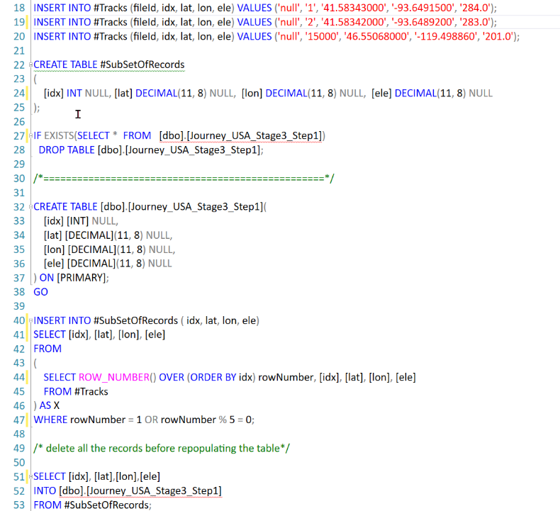
Notes:
Reduce the number of points by only selecting 1 out of 5

Slide 79
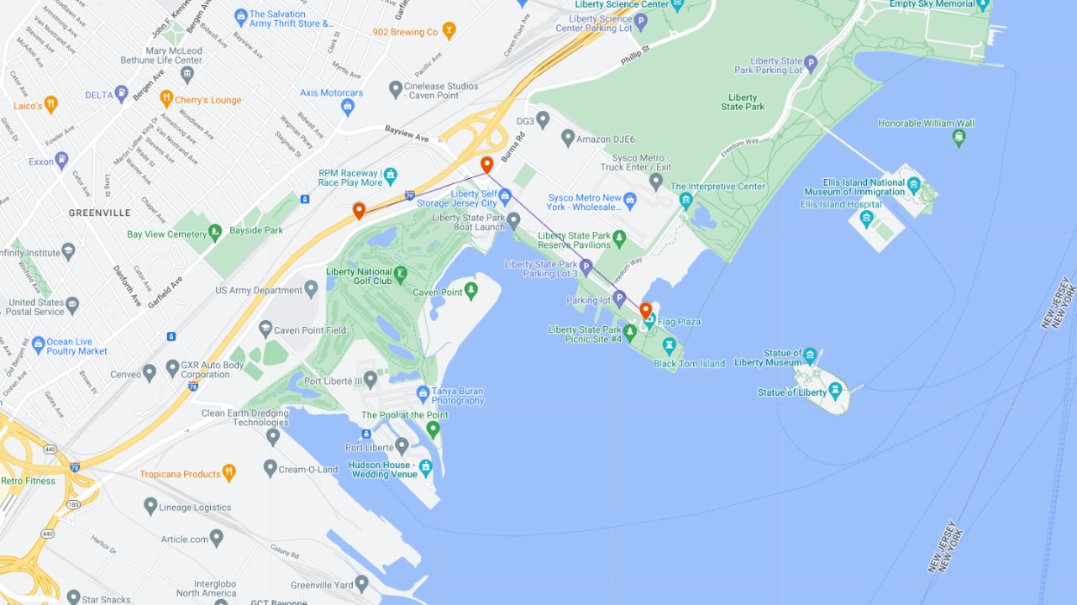
?
?

Slide 80


Slide 81

Notes:
Photo by Pixabay: https://www.pexels.com/photo/scientific-calculator-on-wooden-surface-220301/

Slide 82


Slide 83
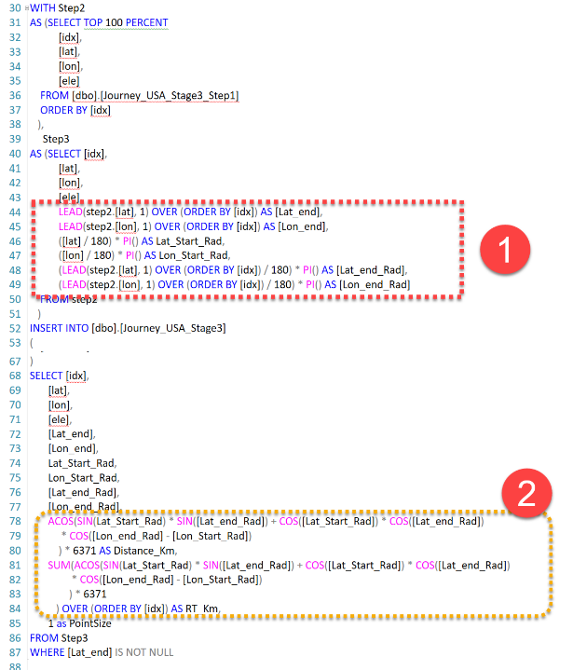

Slide 84
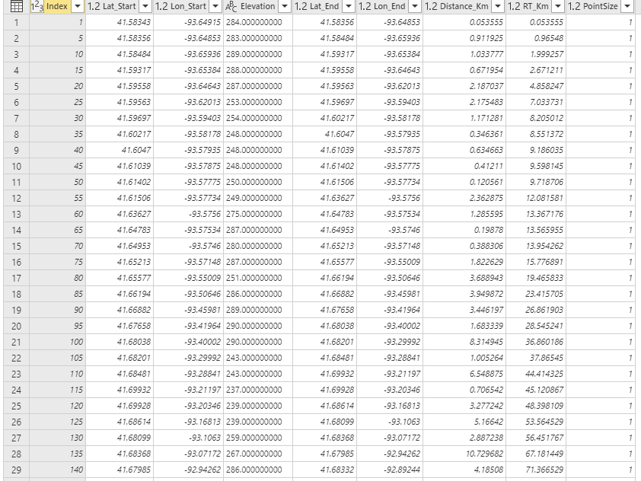
Distance from Starting Point to End Point
= 2.2 KM
Total distance to the End Point = 23.4 KM

Slide 85
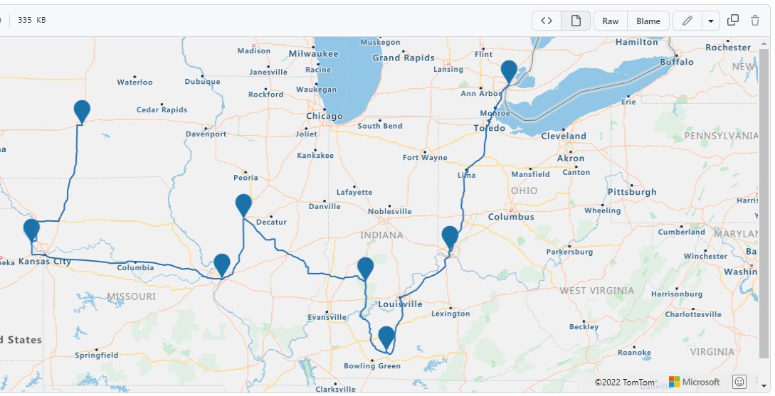
Notes:
From the gpsx file created a GEOJESON file

Slide 86
What do you get?

Slide 87
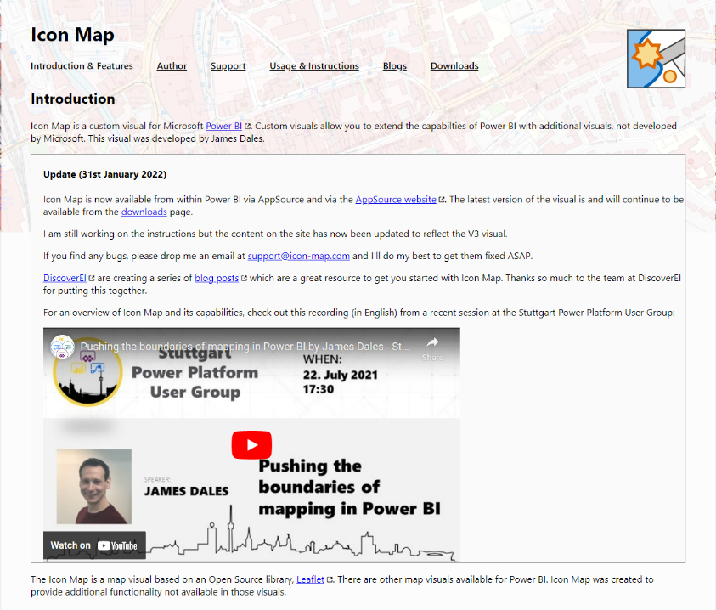
https://icon-map.com/

Slide 88
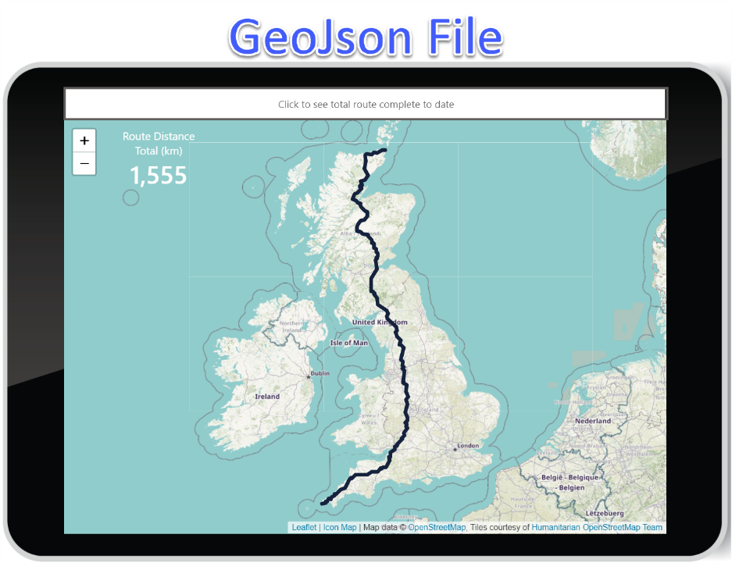
Notes:
GeoJson file to show the journey we are taking

Slide 89
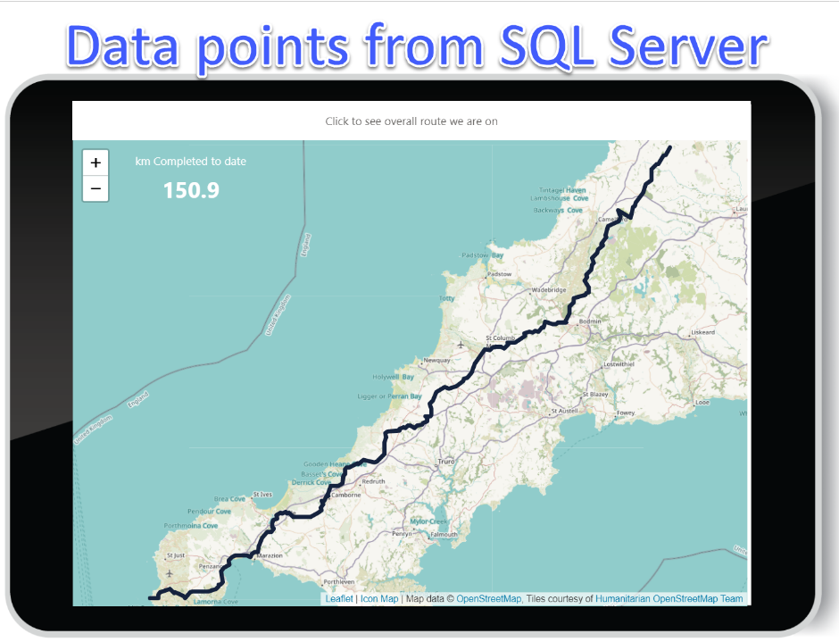
Notes:
This shows how far along the route we have managed to get?

Slide 90

V2.?

Slide 91
Notes:
Photo by Sean Foster on Unsplash
We also might speak about some of the unexpected detours we encountered as we over came some challenges

Slide 92


Slide 93
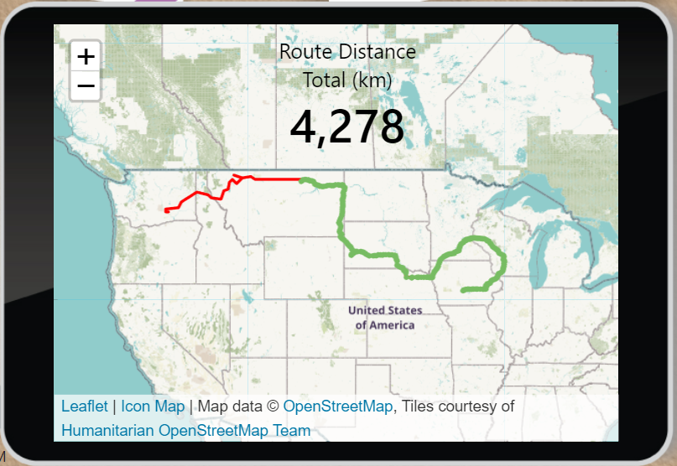
Overall
Route
(to complete)
Route
Completed

Slide 94

Notes:
Photo by MART PRODUCTION: https://www.pexels.com/photo/tired-man-touching-his-eyes-7255264/
Yes Robert did miss the memo about accessibility and colour blindnesses

Slide 95
Notes:
Photo by Los Muertos Crew: https://www.pexels.com/photo/a-baker-making-a-cake-in-a-kitchen-8477963/
Adding icing to the cake

Slide 96
“Power Automate is amazing!
I have an idea…..”

Slide 97
“Ok…..
What’s the idea?”

Slide 98
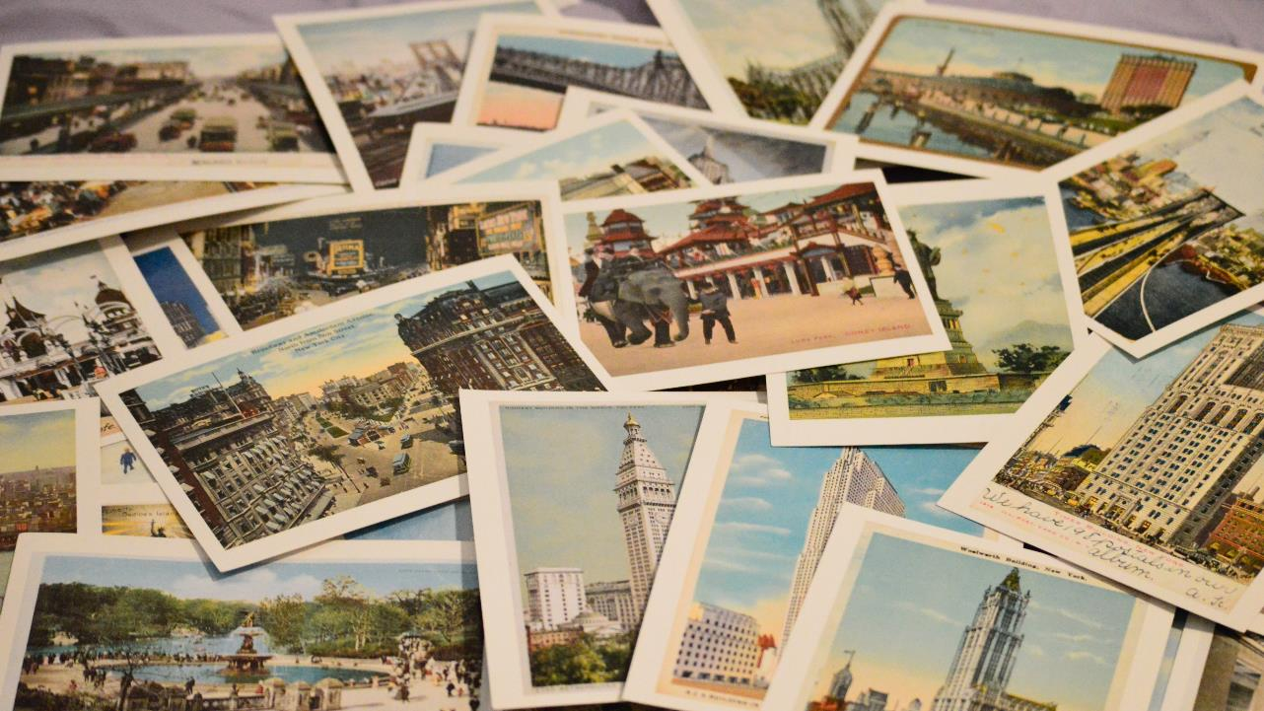
Notes:
Photo by Becky Phan on Unsplash

Slide 99
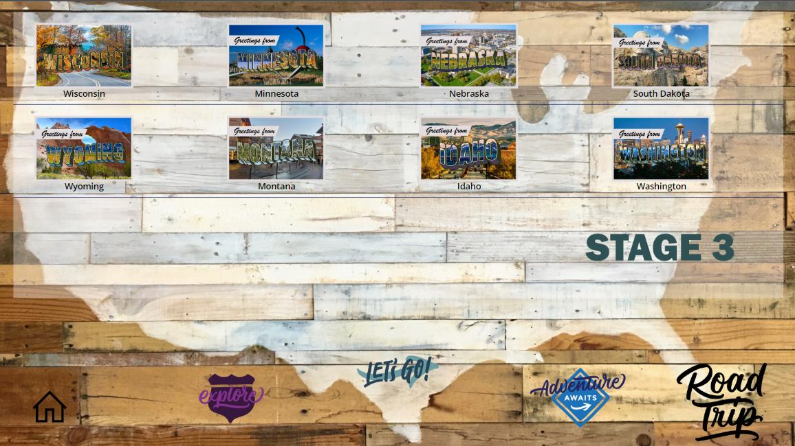

Slide 100
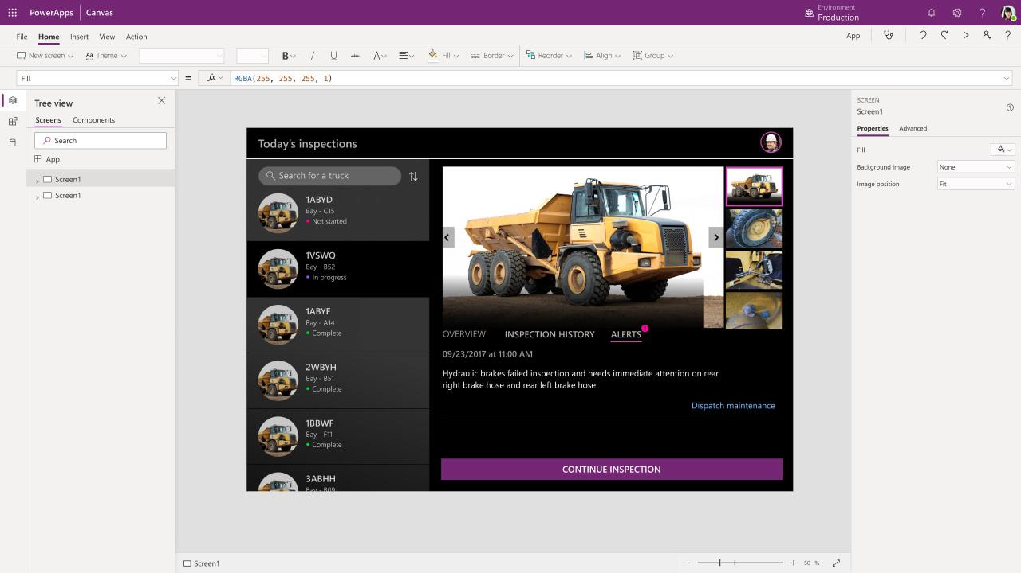
Notes:
Thanks Rob.
Hands up who knows what a Power App is.
And hands up who has experience of developing a Power App.
Great. For those who don’t know, Power Apps are a low code/no code solution so people with no coding experience can create apps.
They can be created in the browser using click-and-drag tools and by setting property values like fonts, colours, etc.

Slide 101
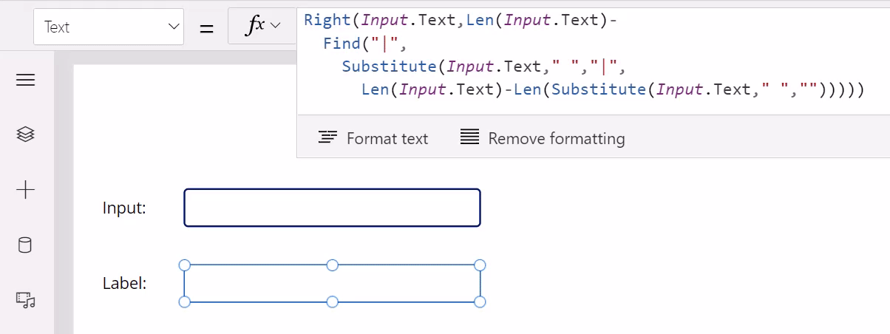
Notes:
And you can use a simple programming language called Power Fx, similar to Excel formulas.

Slide 102
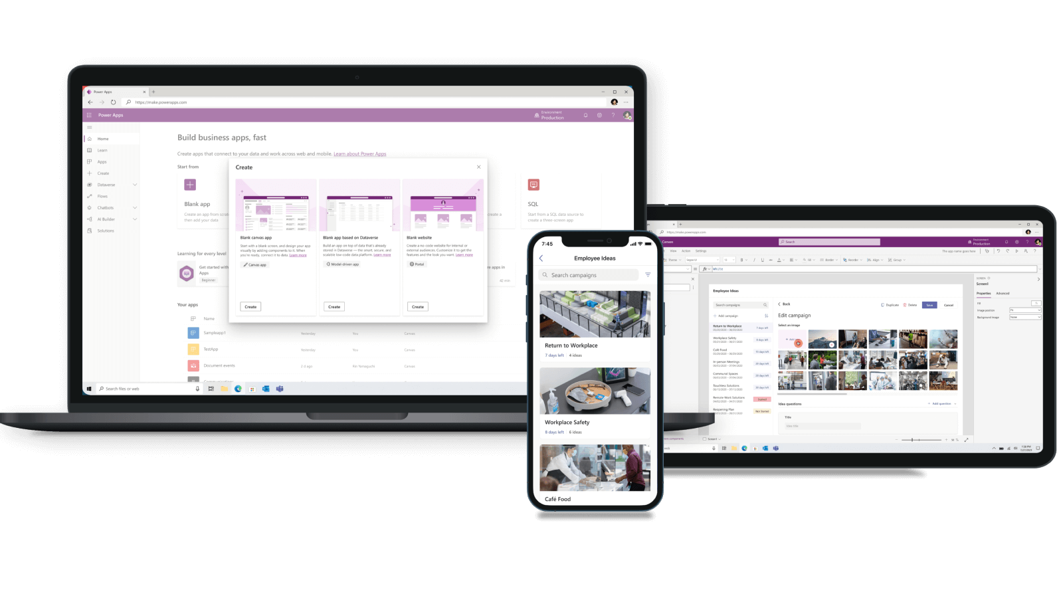
Notes:
Non-coders who develop Power Apps are sometimes referred to as “Citizen Developers” or “Citizen Makers”.
And when Citizen Developers and Pro Developers (like myself) work together, it’s sometimes referred to as “Fusion Development”, which is what’s been the case on this project.

Slide 103
Notes:
So, as you can see, Darren the Marketing Wizard and Rob the Data Guru have done all this amazing work, and now have a working Power App.

Slide 104

Notes:
Game over, right? Why would we need a coder? The Power Platform has allowed non-coders to create an awesome app.
As you saw, the UI looks great…

Slide 105

Notes:
And you wouldn’t typically want a coder’s input for that…

Slide 106

Notes:
And the data access and the Power BI reporting has been taken care of too.
So, how can I help?
Well, one thing a coder can help with is: Making things interactive and reusable.

Slide 107

Notes:
The original plan was to have a main screen like this containing buttons for each of the 48 contiguous states of the US.
Btw this screenshot is of the latest version of the app showing just Stage 3 which is only 8 states - but originally the plan was to show all states together.
When clicking one of the state buttons, the postcard screen for that state would be shown, filling the screen.

Slide 108
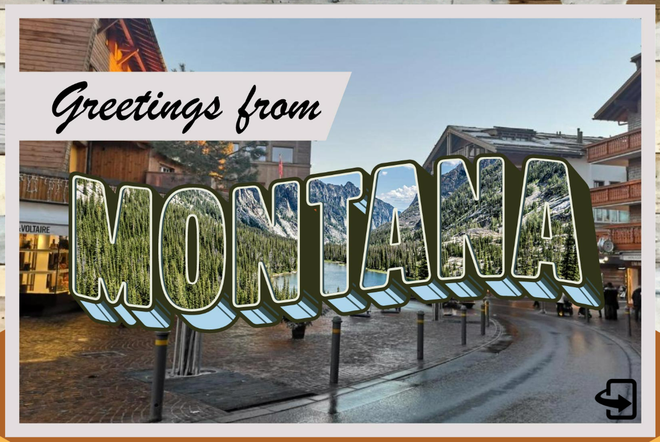
Notes:
Here’s Montana as an example. So far, so good, right?
But, hang on, if we change the logic behind one button click, we have to change the logic behind all 48 buttons!
Also, if we want to change the button format like the size, image, text, etc then, again, we have to change all 48 buttons!
That’s obviously very cumbersome so we needed a way to make this more reusable.

Slide 109
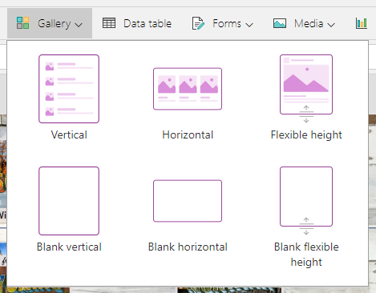
Notes:
The solution we used was to use a Gallery control. This works like a Grid or ListView control where rows are repeated.
This control was then connected to the database table containing all the state data.
So, changing the gallery cell format then changed all postcard buttons.
Much more efficient!

Slide 110

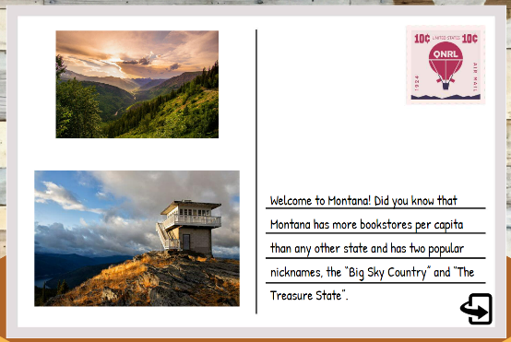
Notes:
Also, initially the app had two postcard screens for each of the 48 states: One for the front (on the left) + one for the back (on the right).
So, New York Front, New York Back, California Front, California Back, etc, you get the point.
So, 48 states front + back means 96 screens!

Slide 111

Notes:
96!
Again, we needed to make things more reusable.

Slide 112
PostcardFrontImage
PostcardFlippedImage1
PostcardFlippedImage2
PostcardFlippedText
Notes:
So, to make life easier, I created a couple of reusable postcard template screens:
A “Postcard Front” template screen (on the left) and swapped out the main image depending on the state selected.
And a “Postcard Back” template screen (on the right) which has two smaller images on the left and a block of text on the right.
Again, everything gets swapped out based on the state selected on the main screen.
This is now also reusable and much more efficient.

Slide 113


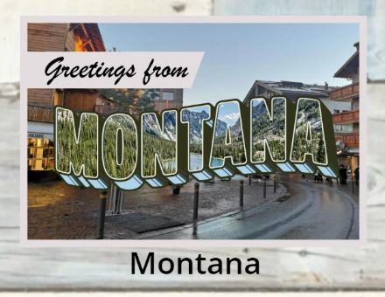
Notes:
Another key feature was to have three modes for each postcard button on the main screen:
- Locked (on the left): a static envelope image.
- Unlocked (in the centre): an animated envelope image.
- And opened (on the right): a postcard thumbnail image.
So we needed logic to reflect these modes.

Slide 114
If(
Lower(Text(LookUp(UserInfo, EmailAddressState = User().Email & "-" & ThisItem.State, PostcardOpened))) = "true",
"appres://resources/" & Substitute(ThisItem.State, " ", "") & "Front",
If(
StravaTotalDistanceKm >= Value(ThisItem.DistanceKm),
EnvelopeLarge,
EnvelopeStatic
)
)
Notes:
To achieve this, code was placed on the gallery cell to show the appropriate image.
So, if the state distance – in this case, Montana – was further than our Strava-recorded distance, then the postcard would be "locked“ because we’ve not yet reached the state.
However, if a state has been reached, that postcard button is “unlocked” and showing the animated envelope image.
And if we then open a state’s postcard, the state’s thumbnail image is shown.
Also, when a postcard is opened, that action is stored in the database for that user.
That means the postcard button will now show a postcard thumbnail image on the main screen going forward.
Having this user data stored centrally in the database means that the postcard thumbnail image will show on any device running the app.
That’ll give the user a consistent experience no matter where they access the app from.

Slide 115
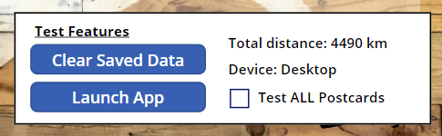
Notes:
We also came up with other "nice touches“.
One of them was developer “Test Features” to show information like total distance logged and debug options like being able to test all postcards.
This was added for the development team only (so, Darren, Rob, and myself) so we could test the app.
We implemented this by showing these “Test Features” controls for specific users only.

Slide 116
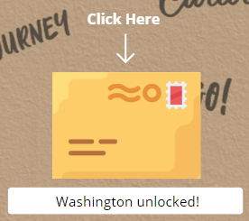
Set(StravaTotalDistanceKm, Value(First(StravaTotalDistance).DistanceKm));
Set(StatesAvailable, Filter(StateInfo, StravaTotalDistanceKm >= Value(DistanceKm)));
Set(FurthestState, First(Sort(StatesAvailable, Value(DistanceKm), SortOrder.Descending)).State);
Set(StateUnlockedMessage, If(!IsBlank(FurthestState), FurthestState & " unlocked!", "Go to states!"));
Notes:
And finally, setting button text to specify the most-recent state unlocked.
This was done by using a formula based on the total distance logged, which is shown at the bottom there.
Again, the code itself isn’t important, this is more about how it works from a high level.
There were other useful features under the bonnet too such as using concurrency when retrieving data for good performance, and things like reusable methods to avoid duplication of effort throughout the app.

Slide 117
Notes:
So, in summary, most of the Power App development that I did was to make it interactive and keep the app working as dynamically and reusable as possible.
This meant that Darren in Marketing could work on the app more efficiently and not have to worry about things like writing code or managing data access.
Darren could then concentrate on important things like the user experience, layout and these awesome graphics.
Rob, back to you.

Slide 118


Slide 119
This is Darren
He is NOT a developer
Notes:
Yes Darren did let me say that ☺

Slide 120

Notes:
Photo by Randy Tarampi on Unsplash

Slide 121
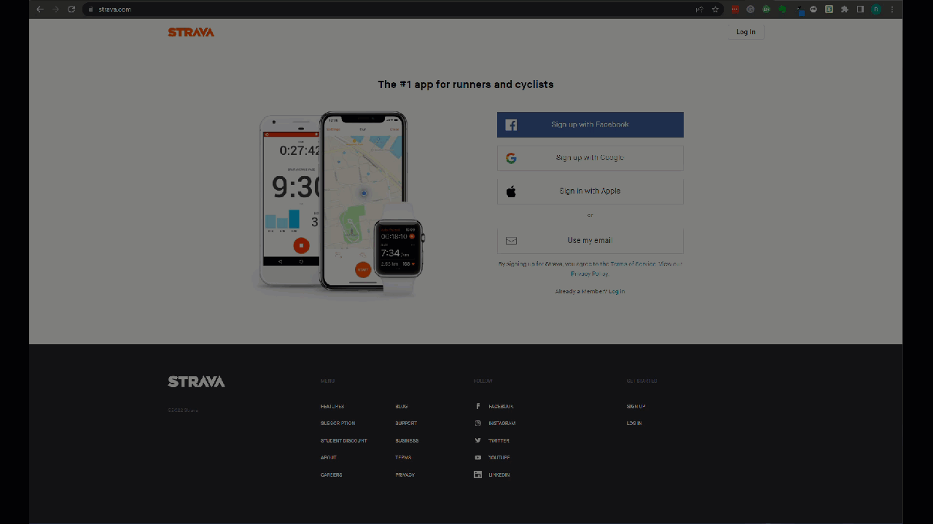

Slide 122

Zero
Notes:
Photo by Hitesh Choudhary on Unsplash

Slide 123
Remember he is NOT a developer
(PS he is very happy about that)
Notes:
Yes Darren did let me say that ☺

Slide 124

Notes:
Photo by Matt Ridley on Unsplash

Slide 125


Slide 126

Notes:
What was the solution?

Slide 127


Slide 128
Logs into Strava
Downloaded file
To folder on desktop
Removes “comma”
Launches azure blob

Slide 129


Slide 130

ED?
Notes:
Photo by david Griffiths on Unsplash

Slide 131

Notes:
Photo by Monica Silvestre: https://www.pexels.com/photo/brown-broom-and-white-plastic-bucket-3562689/
Still not finished yet!

Slide 132
This is past Robert
He was not efficient

Slide 133
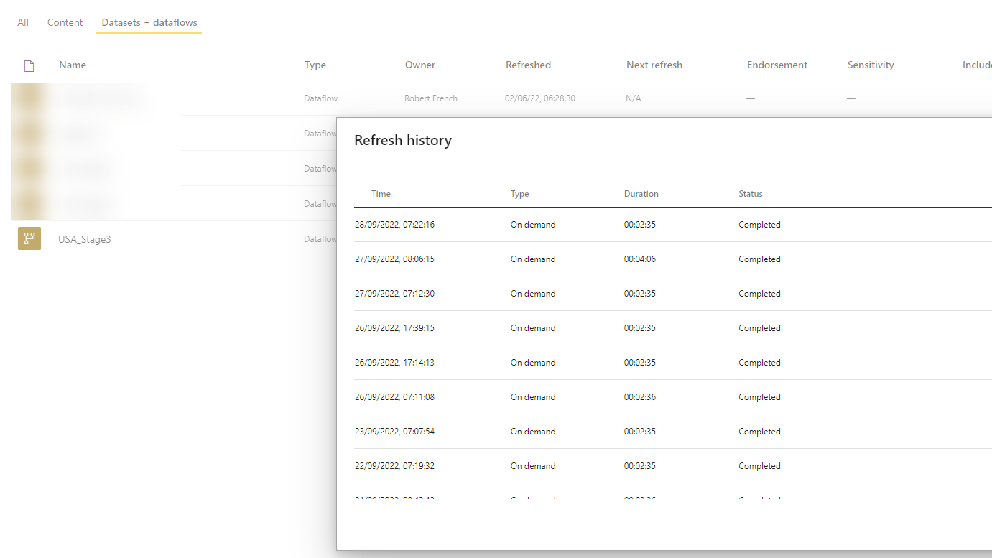
Notes:
Robert manually refreshed the DataFlow and Datasets each day

Slide 134

Notes:
Photo by Matthew Henry on Unsplash
This was sad

Slide 135
Notes:
Photo by Sean Foster on Unsplash
We also might speak about some of the unexpected detours we encountered as we over came some challenges

Slide 136

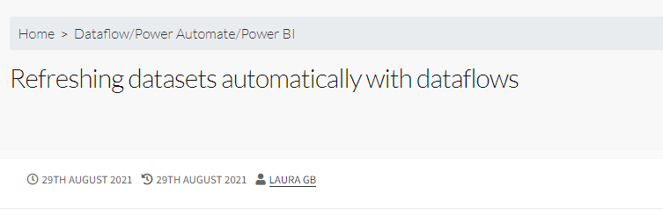
https://hatfullofdata.blog/refreshing-datasets-automatically-with-dataflows/

Slide 137

Notes:
Photo by Marcel Eberle on Unsplash

Slide 138
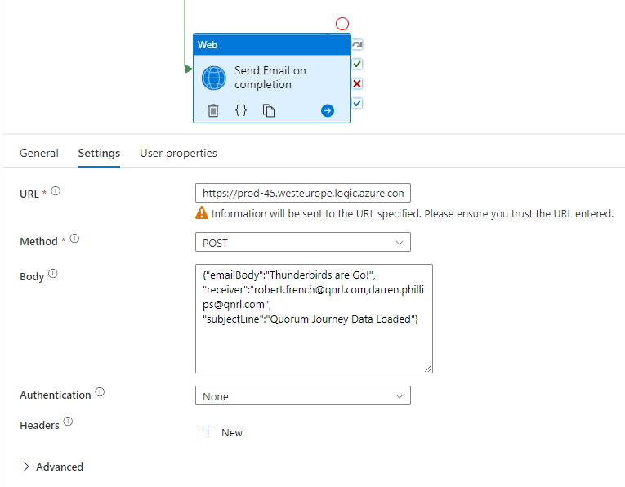
Notes:
In ADF send email so could be processed by

Slide 139
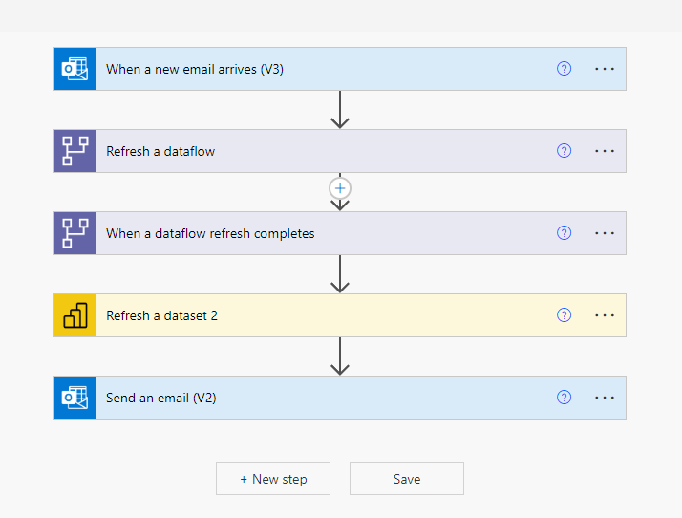

Slide 140





Slide 141


Slide 142
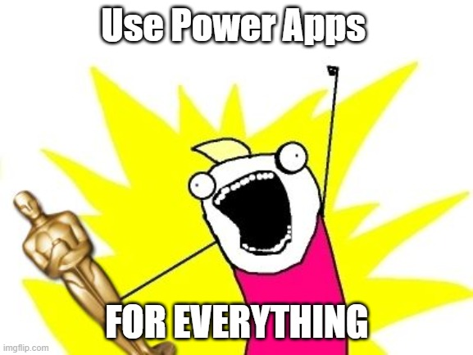
Notes:
I felt like this !

Slide 143

Notes:
Photo by Brett Jordan on Unsplash
Felt a little chaotic

Slide 144

Notes:
Photo by todd kent on Unsplash
Whilst it worked did feel messy

Slide 145

Notes:
Photo by Waldemar Brandt on Unsplash

Slide 146
Notes:
Photo by Sean Foster on Unsplash
We also might speak about some of the unexpected detours we encountered as we over came some challenges

Slide 147

Notes:
Photo by Nicolas Houdayer on Unsplash
One whilst day dreaming and looking a solution for a client noticed something about Azure Logic Apps

Slide 148


Slide 149
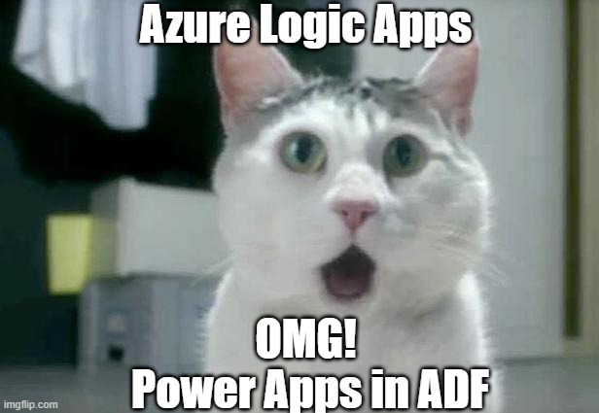
Notes:
Yes I know its not Power Apps in ADF

Slide 150
Notes:
Last step in the ADF pipeline was to send an email (organ

Slide 151
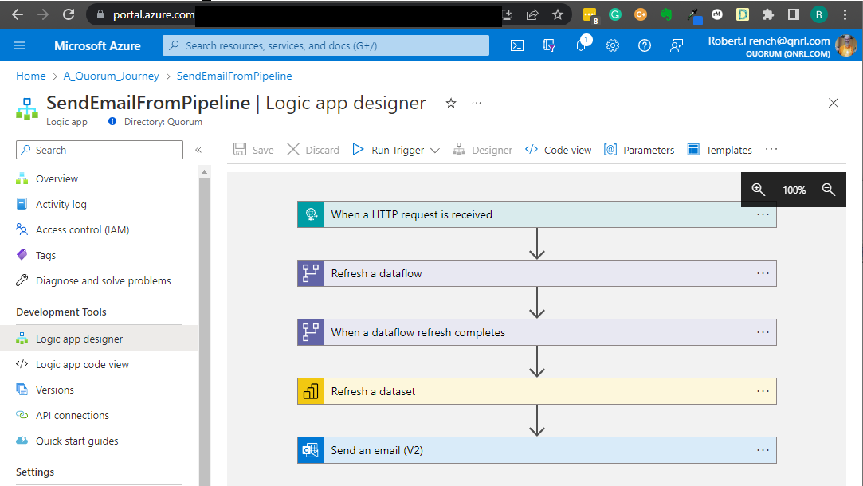

Slide 152


Slide 153

TLDL
(Too Long, Didn't Listen)
Notes:
Photo by Kelly Sikkema on Unsplash

Slide 154
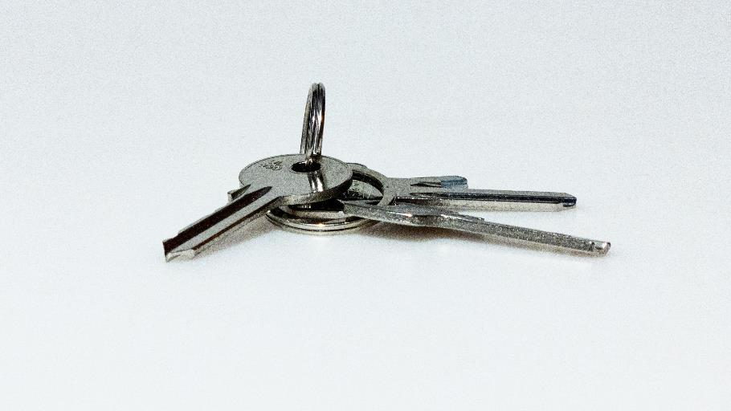
Notes:
Photo by Jozsef Hocza on Unsplash
What are the key

Slide 155

Notes:
Photo by Clem Onojeghuo on Unsplash
What at the key takeaways?

Slide 156


Slide 157

Notes:
Photo by Nathan Dumlao on Unsplash
Ask for help if you do not know ask

Slide 158

Notes:
Photo by Brett Jordan on Unsplash
Help others show them what you have done , share your knowledge

Slide 159
Notes:
Photo by FORTYTWO on Unsplash
This project is like lego bricks we have taken small parts and combined them into one larger project

Slide 160
Notes:
Photo by Phil Hearing on Unsplash
To make something unique yes not everyone will like it ☺

Slide 161

Notes:
Photo by Nick Fewings on Unsplash
Teamwork

Slide 162

Notes:
Photo by Hannah Busing on Unsplash
Credit to some other members of the team

Slide 163

Credits
Tom “@SQLTomato” Skyes
ADF assistance
General good guy
Name of the project.

Slide 164

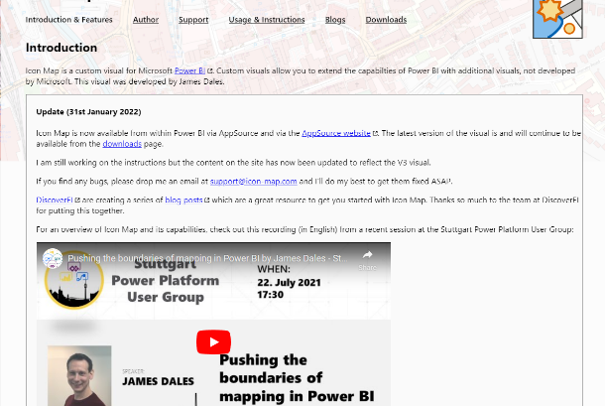
Credits
James Dales
The amazing dev who created Icon Map!
Icon-map.com

Slide 165
Laura Graham-Brown
Sharing ideas, and inspiration

Slide 166
Darren Phillips
Marketing Guru
Graphics Genius
Fantastic Barista
Darren.Phillips@qnrl.com
@DaristaBarista
linkedin.com/in/darrenphillips1984/
https://www.qnrl.com/

Slide 167
Keith Atherton
Senior Developer with Quorum
Lives near Edinburgh, Scotland
[Not from there originally 🤫]
Keith.Atherton@qnrl.com
@MrKeithAtherton
https://www.linkedin.com/in/keith-atherton/
https://www.qnrl.com/

Slide 168
Robert French
Chief Power BI Nerd with Quorum
Lives in Sunny Glasgow, Scotland
Robert.French@qnrl.com
@sqlbobscot
https://www.linkedin.com/in/rwlpfrench/
https://www.qnrl.com/

Slide 169
Sponsors
Thank you!
We couldn’t do it without you.

Slide 170

datarelay.co.uk/feedback
Notes:
Photo by ROCKETMANN TEAM: https://www.pexels.com/photo/persons-doing-a-thumbs-down-9486688/

Slide 171

datarelay.co.uk/feedback
Notes:
Photo by William Fortunato : https://www.pexels.com/photo/unrecognizable-multiracial-guys-showing-thumbs-up-gesture-6140709/

Slide 172
bit.ly/3fpjn5V

Slide 173
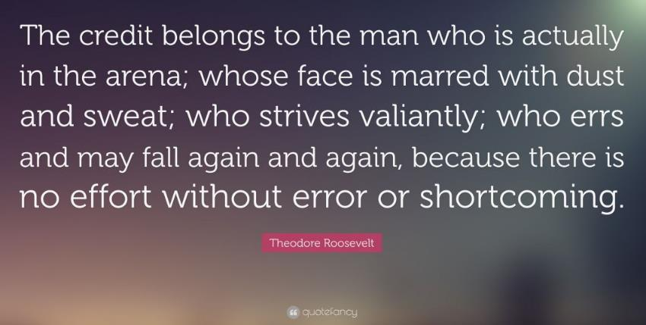

Slide 174

Notes:
Photo by Katrina Wright on Unsplash

